Slide 1




Python

Slide 2


Python Classes and Objects
A class is a user-defined blueprint or prototype from which objects are created. Classes provide a means of bundling data and functionality together. Creating a new class creates a new type of object, allowing new instances of that type to be made.
An Object is an instance of a Class. A class is like a blueprint while an instance is a copy of the class with actual values.

Slide 3
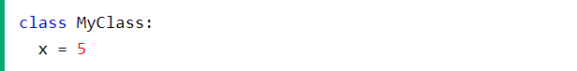
Create a Class
Classes are created by keyword class.
Attributes are the variables that belong to a class.
Attributes are always public and can be accessed using the dot (.) operator. Eg.: Myclass.Myattribute
Class Definition Syntax:
class ClassName:
# Statement-1
.
.
.
# Statement-N

Slide 4
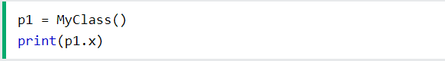
Create Object
When an object of a class is created, the class is said to be instantiated. All the instances share the attributes and the behavior of the class. But the values of those attributes, i.e. the state are unique for each object.
Example:

Slide 5
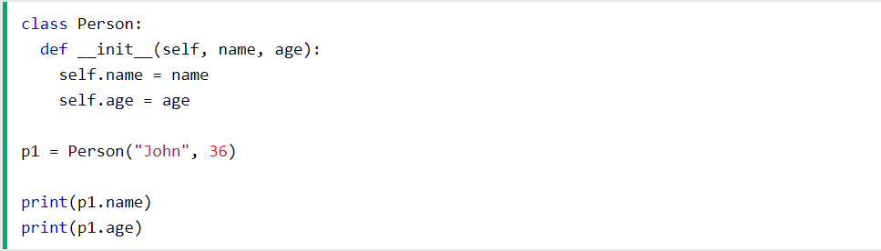
The __init__() Function
The __init__ method is similar to constructors in C++ and Java. Constructors are used to initializing the object’s state. Like methods, a constructor also contains a collection of statements(i.e. instructions) that are executed at the time of Object creation. It runs as soon as an object of a class is instantiated. The method is useful to do any initialization you want to do with your object.
Example: Create a class named Person, use the __init__() function to assign values for name and age:

Slide 6
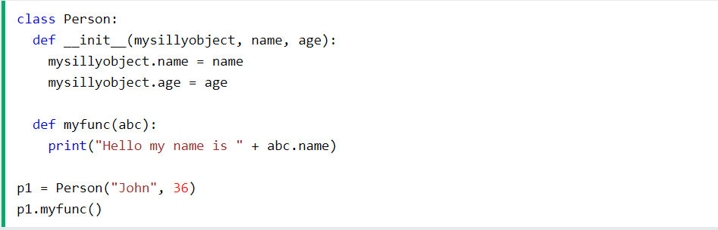
The self Parameter
self represents the instance of the class. By using the “self” keyword we can access the attributes and methods of the class in python. It binds the attributes with the given arguments.
Example: Use the words mysillyobject and abc instead of self:

Slide 7
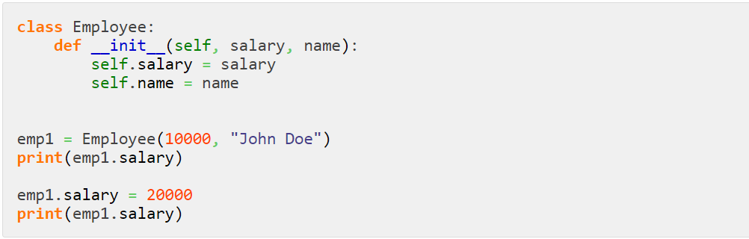
Modify Object Properties
You can modify properties on objects like this:
Example:

Slide 8
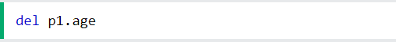
Delete Object Properties
The del keyword in python is primarily used to delete object properties in Python. Since everything in python represents an object in one way or another, the del keyword can also be used to delete a list, slice a list, delete a dictionaries, remove key-value pairs from a dictionary, delete variables, etc.
Example: Delete the age property from the p1 object:

Slide 9
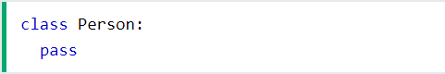
The pass Statement
Class definitions cannot be empty, but if you for some reason have a class definition with no content, put in the pass statement to avoid getting an error.
Example:

Slide 10
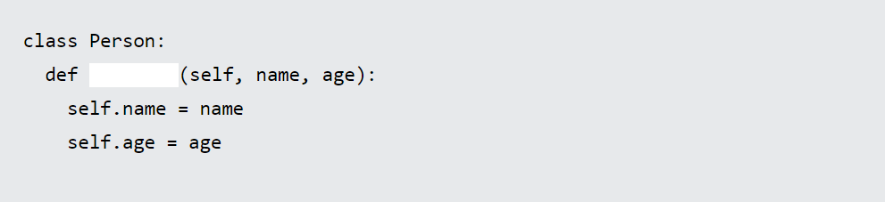
Exercise
1. What is the correct syntax to assign a "init" function to a class?

Slide 11
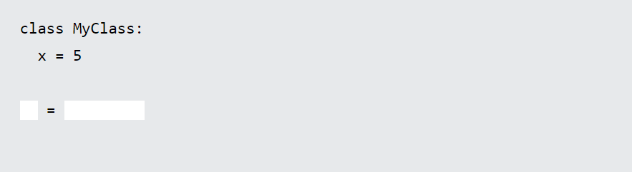
Exercise
3. Create an object of MyClass called p1:

Slide 12
Python Inheritance
Inheritance is the capability of one class to derive or inherit the properties from another class. The benefits of inheritance are:
It represents real-world relationships well.
It provides reusability of a code. We don’t have to write the same code again and again. Also, it allows us to add more features to a class without modifying it.
It is transitive in nature, which means that if class B inherits from another class A, then all the subclasses of B would automatically inherit from class A.
Parent class is the class being inherited from, also called base class.
Child class is the class that inherits from another class, also called derived class.

Slide 13
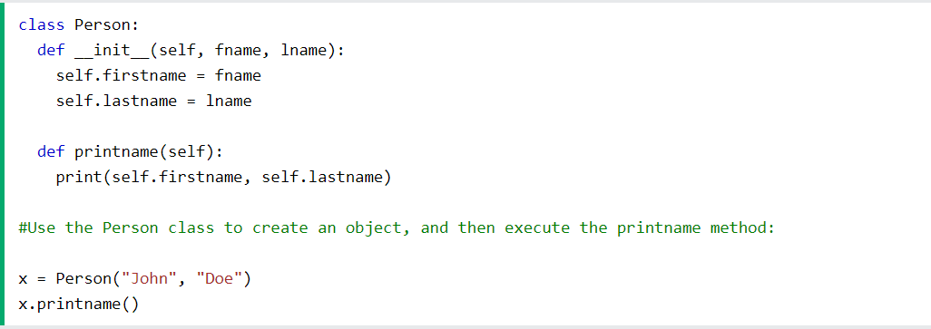
Create a Parent Class
Any class can be a parent class, so the syntax is the same as creating any other class.
Example: Create a class named Person, with firstname and lastname properties, and a printname method:

Slide 14
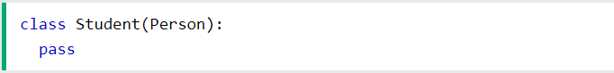
Create a Child Class
To create a class that inherits the functionality from another class, send the parent class as a parameter when creating the child class.
Example: Create a class named Student, which will inherit the properties and methods from the Person class:
Now the Student class has the same properties and methods as the Person class.

Slide 15
Create a Child Class
To create a class that inherits the functionality from another class, send the parent class as a parameter when creating the child class.
Example: Create a class named Student, which will inherit the properties and methods from the Person class:
Now the Student class has the same properties and methods as the Person class.

Slide 16
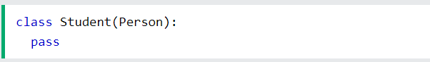
Python Inheritance
Create a Child Class
To create a class that inherits the functionality from another class, send the parent class as a parameter when creating the child class:
Example
Create a class named Student, which will inherit the properties and methods from the Person class:
Note: Use the pass keyword when you do not want to add any other properties or methods to the class.

Slide 17
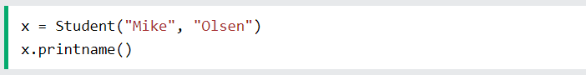
Python Inheritance
Now the Student class has the same properties and methods as the Person class.
Example
Use the Student class to create an object, and then execute the printname method:

Slide 18
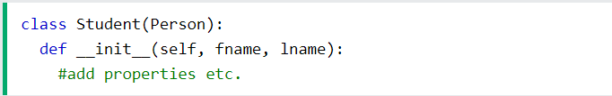
Python Inheritance
Add the __init__() Function
So far we have created a child class that inherits the properties and methods from its parent.
We want to add the __init__() function to the child class (instead of the pass keyword).
Example
Add the __init__() function to the Student class:
Note: The __init__() function is called automatically every time the class is being used to create a new object.

Slide 19
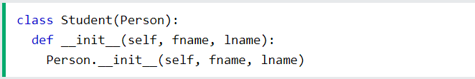
Python Inheritance
When you add the __init__() function, the child class will no longer inherit the parent's __init__() function.
To keep the inheritance of the parent's __init__() function, add a call to the parent's __init__() function:
Example
Note: The child's __init__() function overrides the inheritance of the parent's __init__() function.

Slide 20
Python Inheritance
When you add the __init__() function, the child class will no longer inherit the parent's __init__() function.
To keep the inheritance of the parent's __init__() function, add a call to the parent's __init__() function:
Example
Now we have successfully added the __init__() function, and kept the inheritance of the parent class, and we are ready to add functionality in the __init__() function.
Note: The child's __init__() function overrides the inheritance of the parent's __init__() function.

Slide 21
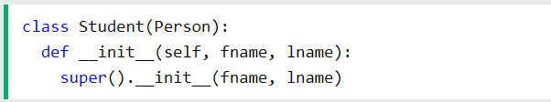
Python Inheritance
Use the super() Function
Python also has a super() function that will make the child class inherit all the methods and properties from its parent:
Example

Slide 22
Python Inheritance
Use the super() Function
Python also has a super() function that will make the child class inherit all the methods and properties from its parent:
Example
By using the super() function, you do not have to use the name of the parent element, it will automatically inherit the methods and properties from its parent.

Slide 23
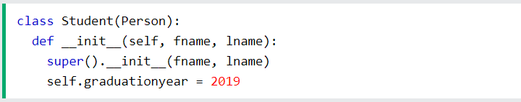
Python Inheritance
In the example below, the year 2019 should be a variable, and passed into the Student class when creating student objects. To do so, add another parameter in the __init__() function:
Add Properties
Example
Add a property called graduationyear to the Student class:
By using the super() function, you do not have to use the name of the parent element, it will automatically inherit the methods and properties from its parent.

Slide 24
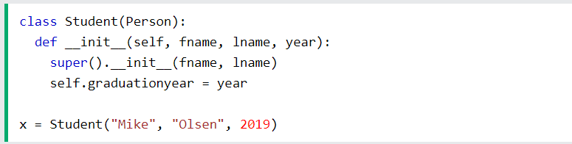
Python Inheritance
By using the super() function, you do not have to use the name of the parent element, it will automatically inherit the methods and properties from its parent.

Slide 25
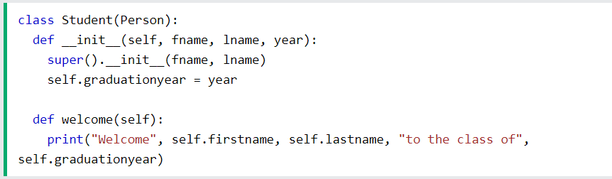
Python Inheritance
Add Methods
Example
Add a method called welcome to the Student class:
If you add a method in the child class with the same name as a function in the parent class, the inheritance of the parent method will be overridden.

Slide 26
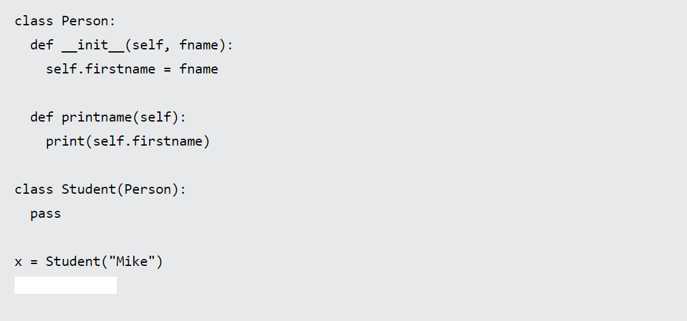
Exercise
1. We have used the Student class to create an object named x.
What is the correct syntax to execute the printname method of the object x?

Slide 27
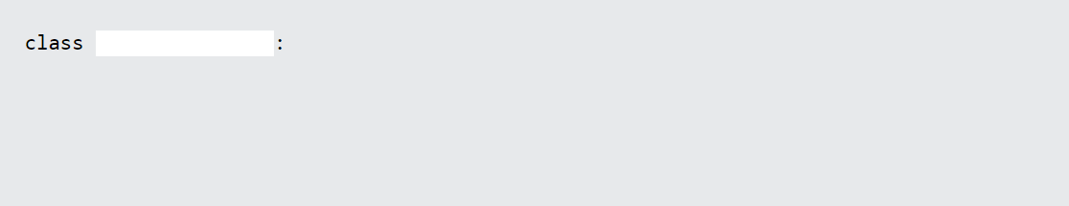
Exercise
2. What is the correct syntax to create a class named Student that will inherit properties and methods from a class named Person?

Slide 28
Python Iterators
Python Iterators
An iterator is an object that contains a countable number of values.
An iterator is an object that can be iterated upon, meaning that you can traverse through all the values.
Technically, in Python, an iterator is an object which implements the iterator protocol, which consist of the methods __iter__() and __next__().

Slide 29
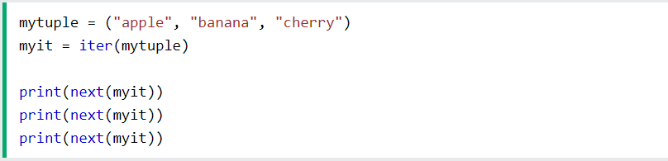
Python Iterators
Iterator vs Iterable
Lists, tuples, dictionaries, and sets are all iterable objects. They are iterable containers which you can get an iterator from.
All these objects have a iter() method which is used to get an iterator:
Example
Return an iterator from a tuple, and print each value:

Slide 30
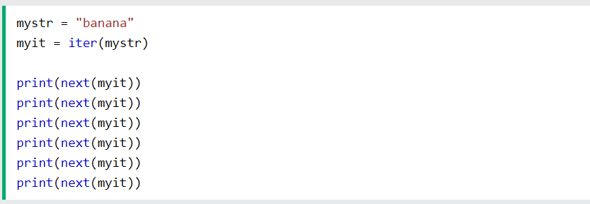
Python Iterators
Even strings are iterable objects, and can return an iterator:
Example
Strings are also iterable objects, containing a sequence of characters:

Slide 31
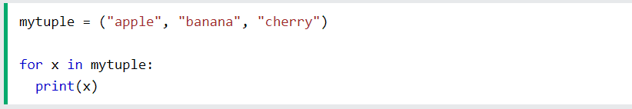
Python Iterators
Looping Through an Iterator
We can also use a for loop to iterate through an iterable object:
Example
Iterate the values of a tuple:

Slide 32
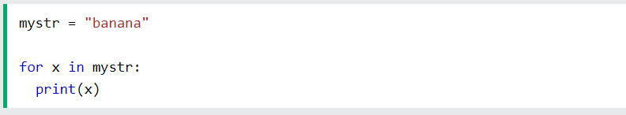
Python Iterators
Example
Iterate the characters of a string:

Slide 33
Python Iterators
Create an Iterator
To create an object/class as an iterator you have to implement the methods __iter__() and __next__() to your object.
As you have learned in the Python Classes/Objects chapter, all classes have a function called __init__(), which allows you to do some initializing when the object is being created.
The __iter__() method acts similar, you can do operations (initializing etc.), but must always return the iterator object itself.
The __next__() method also allows you to do operations, and must return the next item in the sequence.

Slide 34
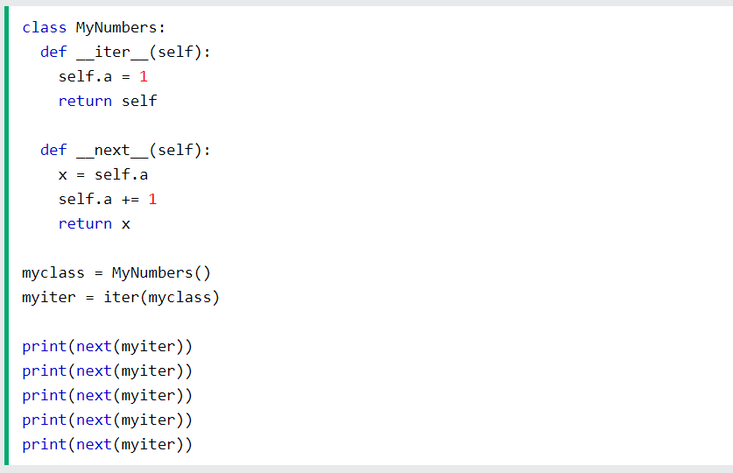
Python Iterators
Example
Create an iterator that returns numbers, starting with 1, and each sequence will increase by one (returning 1,2,3,4,5 etc.):

Slide 35
Python Iterators
StopIteration
The example above would continue forever if you had enough next() statements, or if it was used in a for loop.
To prevent the iteration to go on forever, we can use the StopIteration statement.
In the __next__() method, we can add a terminating condition to raise an error if the iteration is done a specified number of times:

Slide 36
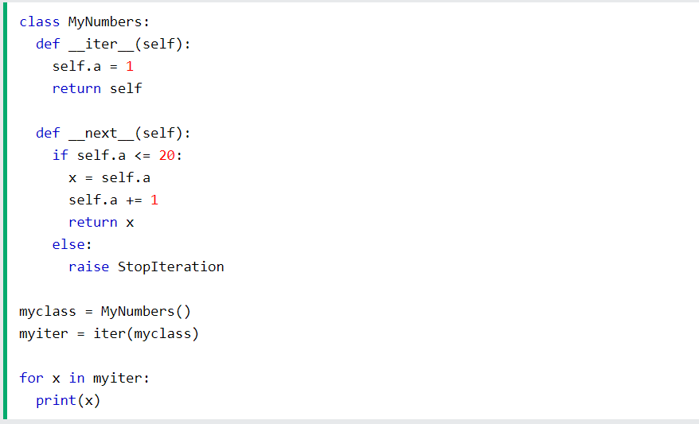
Python Iterators
Example
Stop after 20 iterations:

Slide 37
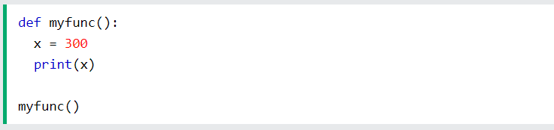
Python Scope
A variable is only available from inside the region it is created. This is called scope.
Local Scope
A variable created inside a function belongs to the local scope of that function, and can only be used inside that function.
Example
A variable created inside a function is available inside that function:

Slide 38
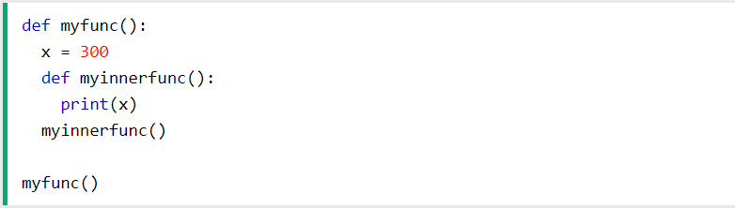
Python Scope
Function Inside Function
As explained in the example above, the variable x is not available outside the function, but it is available for any function inside the function:
Example
The local variable can be accessed from a function within the function:

Slide 39
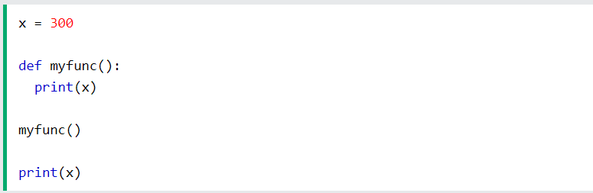
Python Scope
Global Scope
A variable created in the main body of the Python code is a global variable and belongs to the global scope.
Global variables are available from within any scope, global and local.
Example
A variable created outside of a function is global and can be used by anyone:

Slide 40
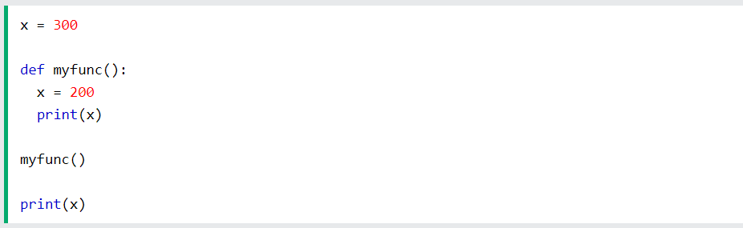
Python Scope
Naming Variables
If you operate with the same variable name inside and outside of a function, Python will treat them as two separate variables, one available in the global scope (outside the function) and one available in the local scope (inside the function):
Example
The function will print the local x, and then the code will print the global x:

Slide 41
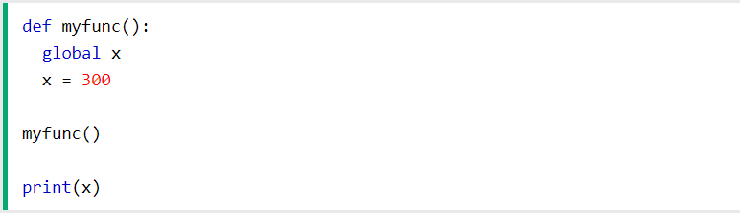
Python Scope
Global Keyword
If you need to create a global variable, but are stuck in the local scope, you can use the global keyword.
The global keyword makes the variable global.
Example
If you use the global keyword, the variable belongs to the global scope:

Slide 42
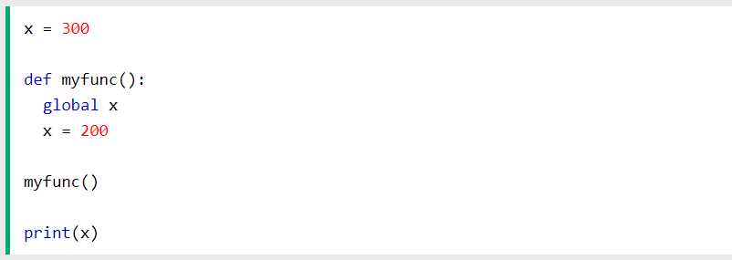
Python Scope
Also, use the global keyword if you want to make a change to a global variable inside a function.
Example
To change the value of a global variable inside a function, refer to the variable by using the global keyword:

Slide 43
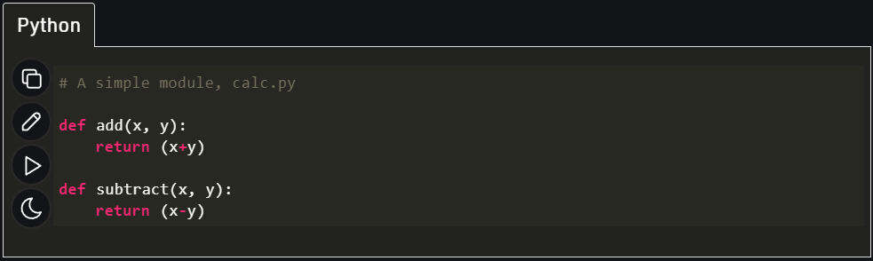
Python Modules
A Python module is a file containing Python definitions and statements. A module can define functions, classes, and variables. A module can also include runnable code. Grouping related code into a module makes the code easier to understand and use. It also makes the code logically organized.
Consider a module to be the same as a code library.
Example:

Slide 44
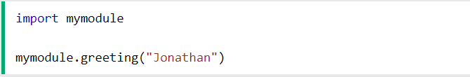
Use a Module
We can import the functions, classes defined in a module to another module using the import statement in some other Python source file.
When the interpreter encounters an import statement, it imports the module if the module is present in the search path. A search path is a list of directories that the interpreter searches for importing a module. For example, to import the module calc.py, we need to put the following command at the top of the script.
Note: This does not import the functions or classes directly instead imports the module only. To access the functions inside the module the dot(.) operator is used.
Example: Import the module named mymodule, and call the greeting function:

Slide 45
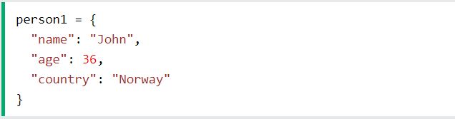
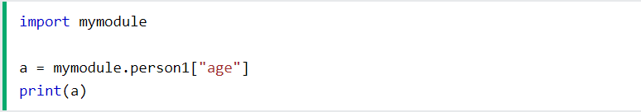
Variables in Module
The module can contain functions, as already described, but also variables of all types (arrays, dictionaries, objects etc):
Example: Save this code in the file mymodule.py
Example: Import the module named mymodule, and access the person1 dictionary:

Slide 46
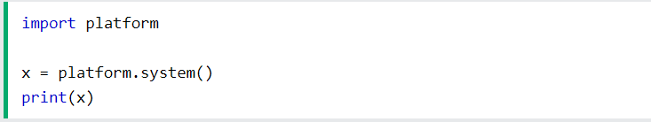
Built-in Modules
Python has a large number of built-in modules. These modules can be used in Python programs by simply importing them using their name followed by the keyword 'import'. In Python, built-in modules are written in C and integrated with the Python interpreter.
In Python, each and every built-in module has a large number of predefined functions to perform specific tasks.
Example:

Slide 47
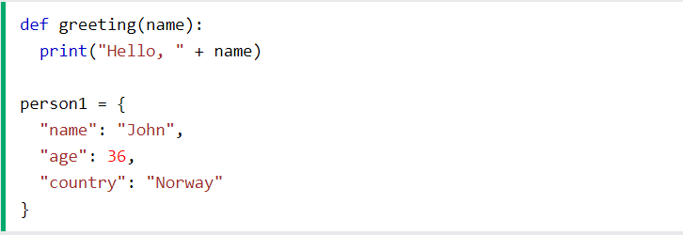
Import from Modules
Python’s from statement lets you import specific attributes from a module without importing the module as a whole.
Example: The module named mymodule has one function and one dictionary:

Slide 48
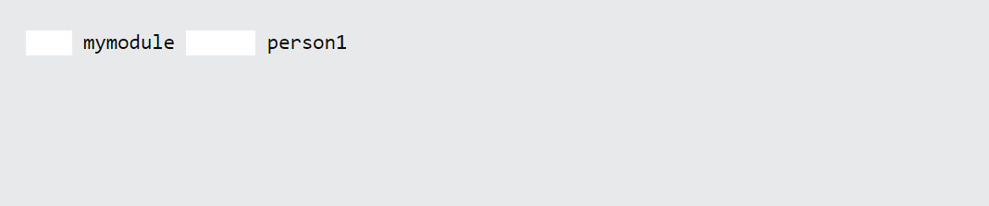
Exercise
1. What is the correct syntax of importing only the person1 dictionary of the "mymodule" module?

Slide 49
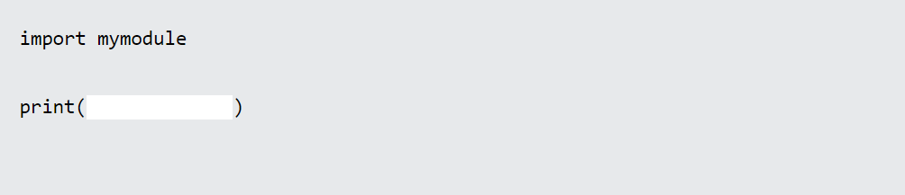
Exercise
2. What is the correct syntax of printing all variables and function names of the "mymodule" module?

Slide 50
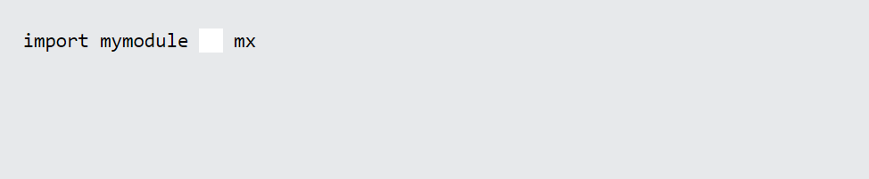
Exercise
3. If you want to refer to a module by using a different name, you can create an alias.
What is the correct syntax for creating an alias for a module?

Slide 51
Exercise
3. If you want to refer to a module by using a different name, you can create an alias.
What is the correct syntax for creating an alias for a module?

Slide 52
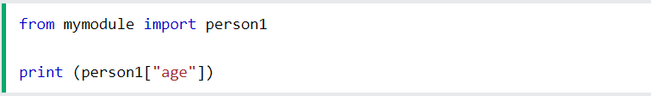
Exercise
Example
Import only the person1 dictionary from the module:
Note: When importing using the from keyword, do not use the module name when referring to elements in the module. Example: person1["age"], not mymodule.person1["age"]

Slide 53
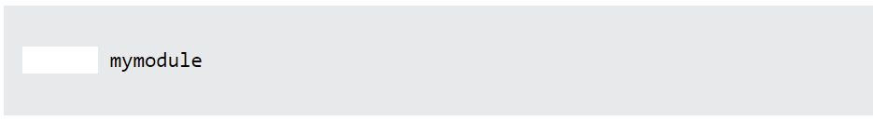
Exercise
Exercise:
What is the correct syntax to import a module named "mymodule"?

Slide 54
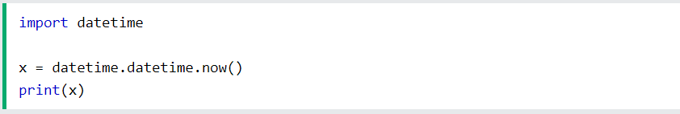
Python Datetime
Python Dates
A date in Python is not a data type of its own, but we can import a module named datetime to work with dates as date objects.
Example
Import the datetime module and display the current date:

Slide 55
Python Datetime
Date Output
When we execute the code from the example above the result will be:
2021-10-15 09:13:32.110780
The date contains year, month, day, hour, minute, second, and microsecond.
The datetime module has many methods to return information about the date object.

Slide 56
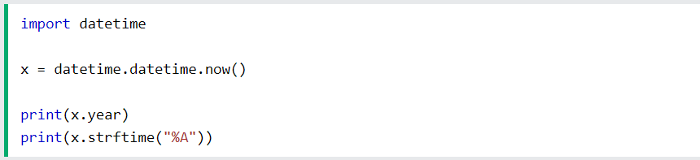
Python Datetime
Here are a few examples, you will learn more about them later in this chapter:
Example
Return the year and name of weekday:

Slide 57
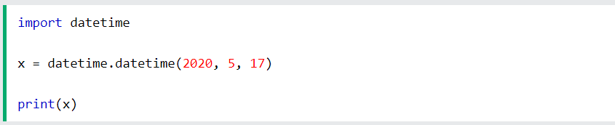
Python Datetime
Creating Date Objects
To create a date, we can use the datetime() class (constructor) of the datetime module.
The datetime() class requires three parameters to create a date: year, month, day.
Example
Create a date object:

Slide 58
Python Datetime
Creating Date Objects
To create a date, we can use the datetime() class (constructor) of the datetime module.
The datetime() class requires three parameters to create a date: year, month, day.
Example
Create a date object:

Slide 59
Python Datetime
Note:- The datetime() class also takes parameters for time and timezone (hour, minute, second, microsecond, tzone), but they are optional, and has a default value of 0, (None for timezone).

Slide 60
Python Datetime
Creating Date Objects
To create a date, we can use the datetime() class (constructor) of the datetime module.
The datetime() class requires three parameters to create a date: year, month, day.
Example
Create a date object:

Slide 61
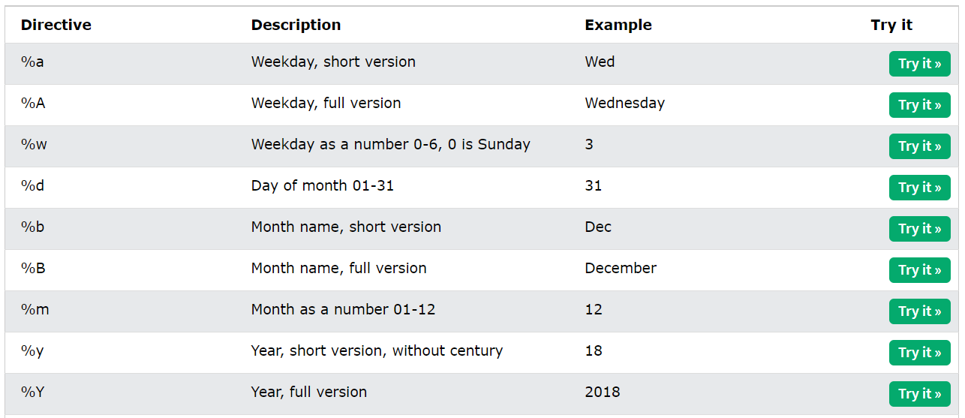
Python Datetime
A reference of all the legal format codes:

Slide 62
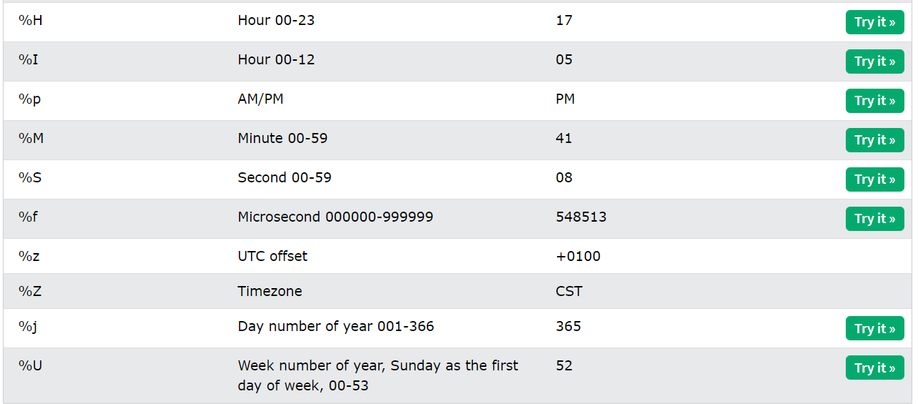
Python Datetime
A reference of all the legal format codes:

Slide 63
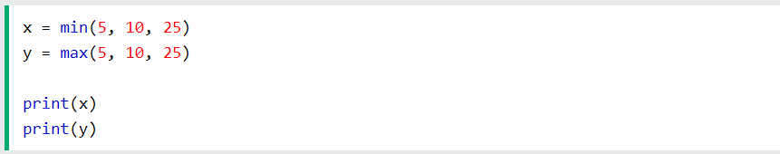
Python Math
Python has a set of built-in math functions, including an extensive math module, that allows you to perform mathematical tasks on numbers.
Built-in Math Functions
The min() and max() functions can be used to find the lowest or highest value in an iterable:
Example

Slide 64

Python Math
The abs() function returns the absolute (positive) value of the specified number:
Example

Slide 65

Python Math
The pow(x, y) function returns the value of x to the power of y (xy).
Example
Return the value of 4 to the power of 3 (same as 4 * 4 * 4):

Slide 66
Python Math
The Math Module
Python has also a built-in module called math, which extends the list of mathematical functions.
To use it, you must import the math module:

Slide 67

Python Math
When you have imported the math module, you can start using methods and constants of the module.
The math.sqrt() method for example, returns the square root of a number:
Example

Slide 68

Python Math
The math.ceil() method rounds a number upwards to its nearest integer, and the math.floor() method rounds a number downwards to its nearest integer, and returns the result:
Example

Slide 69

Python Math
The math.pi constant, returns the value of PI (3.14...):
Example

Slide 70
Python JSON
JSON is a syntax for storing and exchanging data.
JSON is text, written with JavaScript object notation.
JSON in Python
Python has a built-in package called json, which can be used to work with JSON data.
Example
Import the json module:

Slide 71

Python JSON
Parse JSON - Convert from JSON to Python
If you have a JSON string, you can parse it by using the json.loads() method.
The result will be a Python dictionary.
Example
Convert from JSON to Python:

Slide 72

Python JSON
Convert from Python to JSON
If you have a Python object, you can convert it into a JSON string by using the json.dumps() method.
Example
Convert from Python to JSON:

Slide 73
Python JSON
You can convert Python objects of the following types, into JSON strings:
dict
list
tuple
string
int
float
True
False
None

Slide 74

Python JSON
Example
Convert Python objects into JSON strings, and print the values:
import json

Slide 75

Python JSON
When you convert from Python to JSON, Python objects are converted into the JSON (JavaScript) equivalent:

Slide 76

Python JSON
Example
Convert a Python object containing all the legal data types:

Slide 77
Python JSON
Format the Result
The example above prints a JSON string, but it is not very easy to read, with no indentations and line breaks.
The json.dumps() method has parameters to make it easier to read the result:
Example
Use the indent parameter to define the numbers of indents:

Slide 78
Python JSON
You can also define the separators, default value is (", ", ": "), which means using a comma and a space to separate each object, and a colon and a space to separate keys from values:
Example
Use the separators parameter to change the default separator:

Slide 79
Python JSON
Order the Result
The json.dumps() method has parameters to order the keys in the result:
Example
Use the sort_keys parameter to specify if the result should be sorted or not:

Slide 80
Python RegEx
A RegEx, or Regular Expression, is a sequence of characters that forms a search pattern.
RegEx can be used to check if a string contains the specified search pattern.
RegEx Module
Python has a built-in package called re, which can be used to work with Regular Expressions.
Import the re module:

Slide 81

Python RegEx
RegEx in Python
When you have imported the re module, you can start using regular expressions:
Example
Search the string to see if it starts with "The" and ends with "Spain":

Slide 82

Python RegEx
RegEx Functions
The re module offers a set of functions that allows us to search a string for a match:

Slide 83

Python RegEx
Metacharacters
Metacharacters are characters with a special meaning:

Slide 84

Python RegEx
Metacharacters
Metacharacters are characters with a special meaning:

Slide 85

Python RegEx
Special Sequences
A special sequence is a \ followed by one of the characters in the list below, and has a special meaning:

Slide 86

Python RegEx
Special Sequences
A special sequence is a \ followed by one of the characters in the list below, and has a special meaning:

Slide 87

Python RegEx
Sets
A set is a set of characters inside a pair of square brackets [] with a special meaning:

Slide 88

Python RegEx
Sets
A set is a set of characters inside a pair of square brackets [] with a special meaning:

Slide 89

Python RegEx
The findall() Function
The findall() function returns a list containing all matches.
Example
Print a list of all matches:

Slide 90

Python RegEx
The list contains the matches in the order they are found.
If no matches are found, an empty list is returned:
Example
Return an empty list if no match was found:

Slide 91

Python RegEx
The search() Function
The search() function searches the string for a match, and returns a Match object if there is a match.
If there is more than one match, only the first occurrence of the match will be returned:
Example
Search for the first white-space character in the string:

Slide 92

Python RegEx
If no matches are found, the value None is returned:
Example
Make a search that returns no match:

Slide 93

Python RegEx
You can control the number of occurrences by specifying the maxsplit parameter:
Example
Split the string only at the first occurrence:

Slide 94

Python RegEx
The sub() Function
The sub() function replaces the matches with the text of your choice:
Example
Replace every white-space character with the number 9:

Slide 95

Python RegEx
You can control the number of replacements by specifying the count parameter:
Example
Replace the first 2 occurrences:

Slide 96

Python RegEx
Match Object
A Match Object is an object containing information about the search and the result.
Example
Do a search that will return a Match Object:
Note: If there is no match, the value None will be returned, instead of the Match Object.

Slide 97
Python RegEx
The Match object has properties and methods used to retrieve information about the search, and the result:
.span() returns a tuple containing the start-, and end positions of the match.
.string returns the string passed into the function
.group() returns the part of the string where there was a match

Slide 98

Python RegEx
Example
Print the position (start- and end-position) of the first match occurrence.
The regular expression looks for any words that starts with an upper case "S":

Slide 99

Python RegEx
Example
Print the string passed into the function:

Slide 100

Python RegEx
Example
Print the part of the string where there was a match.
The regular expression looks for any words that starts with an upper case "S":

Slide 101
Python RegEx
Example
Print the part of the string where there was a match.
The regular expression looks for any words that starts with an upper case "S":
Note: If there is no match, the value None will be returned, instead of the Match Object.

Slide 102
Python PIP
What is PIP?
PIP is a package manager for Python packages, or modules if you like.
What is a Package?
A package contains all the files you need for a module.
Modules are Python code libraries you can include in your project.

Slide 103
Python PIP
Example
Check PIP version:
Check if PIP is Installed
Navigate your command line to the location of Python's script directory, and type the following:

Slide 104

Python PIP
Now you have downloaded and installed your first package!
Using a Package
Once the package is installed, it is ready to use.
Import the "camelcase" package into your project.
Example
Import and use "camelcase":

Slide 105
Python PIP
Find Packages
Find more packages at https://pypi.org/.
Remove a Package
Use the uninstall command to remove a package:
Example
Uninstall the package named "camelcase":

Slide 106
Python PIP
Find Packages
Find more packages at https://pypi.org/.
Remove a Package
Use the uninstall command to remove a package:
Example
Uninstall the package named "camelcase":

Slide 107

Python PIP
The PIP Package Manager will ask you to confirm that you want to remove the camelcase package:

Slide 108
Python PIP
The PIP Package Manager will ask you to confirm that you want to remove the camelcase package:
Press y and the package will be removed.

Slide 109

Python PIP
List Packages
Use the list command to list all the packages installed on your system:
Example
List installed packages:
Result:

Slide 110
Python Try Except
The try block lets you test a block of code for errors.
The except block lets you handle the error.
The finally block lets you execute code, regardless of the result of the try- and except blocks.

Slide 111

Python Try Except
Exception Handling
When an error occurs, or exception as we call it, Python will normally stop and generate an error message.
These exceptions can be handled using the try statement:
Example
The try block will generate an exception, because x is not defined:

Slide 112
Python Try Except
Since the try block raises an error, the except block will be executed.
Without the try block, the program will crash and raise an error:
Example
This statement will raise an error, because x is not defined:

Slide 113

Python Try Except
Many Exceptions
You can define as many exception blocks as you want, e.g. if you want to execute a special block of code for a special kind of error:
Example
Print one message if the try block raises a NameError and another for other errors:

Slide 114

Python Try Except
Else
You can use the else keyword to define a block of code to be executed if no errors were raised:
Example
In this example, the try block does not generate any error:

Slide 115

Python Try Except
Finally
The finally block, if specified, will be executed regardless if the try block raises an error or not.
Example

Slide 116

Python Try Except
This can be useful to close objects and clean up resources:
Example
Try to open and write to a file that is not writable:

Slide 117

Python Try Except
Raise an exception
As a Python developer you can choose to throw an exception if a condition occurs.
To throw (or raise) an exception, use the raise keyword.
Example
Raise an error and stop the program if x is lower than 0:

Slide 118

Python Try Except
The raise keyword is used to raise an exception.
You can define what kind of error to raise, and the text to print to the user.
Example
Raise a TypeError if x is not an integer:

Slide 119
Python Try Except
Python User Input
User Input
Python allows for user input.
That means we are able to ask the user for input.
The method is a bit different in Python 3.6 than Python 2.7.
Python 3.6 uses the input() method.
Python 2.7 uses the raw_input() method.

Slide 120


Python Try Except
The following example asks for the username, and when you entered the username, it gets printed on the screen:
Python 3.6
Python 2.7

Slide 121
Python String Formatting
To make sure a string will display as expected, we can format the result with the format() method.
String format()
The format() method allows you to format selected parts of a string.
Sometimes there are parts of a text that you do not control, maybe they come from a database, or user input?
To control such values, add placeholders (curly brackets {}) in the text, and run the values through the format() method:

Slide 122

Python String Formatting
Example
Add a placeholder where you want to display the price:
You can add parameters inside the curly brackets to specify how to convert the value:
Example
Format the price to be displayed as a number with two decimals:

Slide 123

Python String Formatting
Multiple Values
If you want to use more values, just add more values to the format() method:
And add more placeholders:
Example

Slide 124

Python String Formatting
Index Numbers
You can use index numbers (a number inside the curly brackets {0}) to be sure the values are placed in the correct placeholders:
Example

Slide 125
Python String Formatting
Index Numbers
You can use index numbers (a number inside the curly brackets {0}) to be sure the values are placed in the correct placeholders:
Example

Slide 126

Python String Formatting
Also, if you want to refer to the same value more than once, use the index number:
Example

Slide 127
Python String Formatting
Named Indexes
You can also use named indexes by entering a name inside the curly brackets {carname}, but then you must use names when you pass the parameter values txt.format(carname = "Ford"):
Example

Slide 128
Python File Open
File handling is an important part of any web application.
Python has several functions for creating, reading, updating, and deleting files.
File Handling
The key function for working with files in Python is the open() function.
The open() function takes two parameters; filename, and mode.
There are four different methods (modes) for opening a file:

Slide 129
Python File Open
"r" - Read - Default value. Opens a file for reading, error if the file does not exist
"a" - Append - Opens a file for appending, creates the file if it does not exist
"w" - Write - Opens a file for writing, creates the file if it does not exist
"x" - Create - Creates the specified file, returns an error if the file exists

Slide 130
Python File Open
In addition you can specify if the file should be handled as binary or text mode
"t" - Text - Default value. Text mode
"b" - Binary - Binary mode (e.g. images)
Syntax
To open a file for reading it is enough to specify the name of the file:

Slide 131

Python File Open
Open a File on the Server
Assume we have the following file, located in the same folder as Python:
demofile.txt

Slide 132

Python File Open
To open the file, use the built-in open() function.
The open() function returns a file object, which has a read() method for reading the content of the file:
Example

Slide 133
Python File Open
If the file is located in a different location, you will have to specify the file path, like this:
Example
Open a file on a different location:

Slide 134
Python File Open
Read Only Parts of the File
By default the read() method returns the whole text, but you can also specify how many characters you want to return:
Example
Return the 5 first characters of the file:

Slide 135

Python File Open
Read Lines
You can return one line by using the readline() method:
Example
Read one line of the file:

Slide 136

Python File Open
By calling readline() two times, you can read the two first lines:
Example
Read two lines of the file:

Slide 137

Python File Open
By looping through the lines of the file, you can read the whole file, line by line:
Example
Loop through the file line by line:

Slide 138

Python File Open
Close Files
It is a good practice to always close the file when you are done with it.
Example
Close the file when you are finish with it:
Note: You should always close your files, in some cases, due to buffering, changes made to a file may not show until you close the file.

Slide 139
Python File Write
Write to an Existing File
To write to an existing file, you must add a parameter to the open() function:
"a" - Append - will append to the end of the file
"w" - Write - will overwrite any existing content

Slide 140

Python File Write
Example
Open the file "demofile2.txt" and append content to the file:

Slide 141

Python File Write
Example
Open the file "demofile3.txt" and overwrite the content:
Note: the "w" method will overwrite the entire file.

Slide 142
Python File Write
Create a New File
To create a new file in Python, use the open() method, with one of the following parameters:
"x" - Create - will create a file, returns an error if the file exist
"a" - Append - will create a file if the specified file does not exist
"w" - Write - will create a file if the specified file does not exist

Slide 143
Python File Write
Example
Create a file called "myfile.txt":
Result: a new empty file is created!
Example
Create a new file if it does not exist:

Slide 144

Python Delete File
Delete a File
To delete a file, you must import the OS module, and run its os.remove() function:
Example
Remove the file "demofile.txt":

Slide 145

Python Delete File
Check if File exist:
To avoid getting an error, you might want to check if the file exists before you try to delete it:
Example
Check if file exists, then delete it:

Slide 146

Python Delete File
Delete Folder
To delete an entire folder, use the os.rmdir() method:
Example
Remove the folder "myfolder":

Slide 147
Python Delete File
Delete Folder
To delete an entire folder, use the os.rmdir() method:
Example
Remove the folder "myfolder":
Note: You can only remove empty folders.

Slide 148

Matplotlib Tutorial

Slide 149
Matplotlib Tutorial
Matplotlib Getting Started
Installation of Matplotlib
If you have Python and PIP already installed on a system, then installation of Matplotlib is very easy.
Install it using this command:

Slide 150
Matplotlib Tutorial
If this command fails, then use a python distribution that already has Matplotlib installed, like Anaconda, Spyder etc.
Import Matplotlib
Once Matplotlib is installed, import it in your applications by adding the import module statement:

Slide 151

Matplotlib Tutorial
Now Matplotlib is imported and ready to use:
Checking Matplotlib Version
The version string is stored under __version__ attribute.
Example

Slide 152
Matplotlib Pyplot
Pyplot
Most of the Matplotlib utilities lies under the pyplot submodule, and are usually imported under the plt alias:

Slide 153

Matplotlib Pyplot
Now the Pyplot package can be referred to as plt.
Example
Draw a line in a diagram from position (0,0) to position (6,250):

Slide 154

Matplotlib Pyplot
Result:

Slide 155
Matplotlib Plotting
Plotting x and y points
The plot() function is used to draw points (markers) in a diagram.
By default, the plot() function draws a line from point to point.
The function takes parameters for specifying points in the diagram.
Parameter 1 is an array containing the points on the x-axis.
Parameter 2 is an array containing the points on the y-axis.
If we need to plot a line from (1, 3) to (8, 10), we have to pass two arrays [1, 8] and [3, 10] to the plot function.

Slide 156

Matplotlib Plotting
Example
Draw a line in a diagram from position (1, 3) to position (8, 10):

Slide 157

Matplotlib Plotting
Result:

Slide 158
Matplotlib Plotting
The x-axis is the horizontal axis.
The y-axis is the vertical axis.
Plotting Without Line
To plot only the markers, you can use shortcut string notation parameter 'o', which means 'rings'.

Slide 159

Matplotlib Plotting
Example
Draw two points in the diagram, one at position (1, 3) and one in position (8, 10):

Slide 160

Matplotlib Plotting
Result:

Slide 161

Matplotlib Plotting
Multiple Points
You can plot as many points as you like, just make sure you have the same number of points in both axis.
Example
Draw a line in a diagram from position (1, 3) to (2, 8) then to (6, 1) and finally to position (8, 10):

Slide 162

Matplotlib Plotting
Result:

Slide 163

Matplotlib Plotting
Default X-Points
If we do not specify the points in the x-axis, they will get the default values 0, 1, 2, 3, (etc. depending on the length of the y-points.
So, if we take the same example as above, and leave out the x-points, the diagram will look like this:
Example
Plotting without x-points:

Slide 164
Matplotlib Plotting
Example
Plotting without x-points:

Slide 165

Matplotlib Plotting
Example
Plotting without x-points:

Slide 166
Matplotlib Plotting
Example
Plotting without x-points:
The x-points in the example above is [0, 1, 2, 3, 4, 5].

Slide 167

Matplotlib Markers
Markers
You can use the keyword argument marker to emphasize each point with a specified marker:
Example
Mark each point with a circle:

Slide 168

Matplotlib Markers
Result:

Slide 169

Matplotlib Markers
Example
Mark each point with a star:

Slide 170

Matplotlib Markers
Result:

Slide 171

Matplotlib Markers
Marker Reference
You can choose any of these markers:

Slide 172

Matplotlib Markers
Marker Reference
You can choose any of these markers:

Slide 173

Matplotlib Markers
Marker Reference
You can choose any of these markers:

Slide 174
Matplotlib Markers
Format Strings fmt
You can use also use the shortcut string notation parameter to specify the marker.
This parameter is also called fmt, and is written with this syntax:
marker|line|color

Slide 175

Matplotlib Markers
Example
Mark each point with a circle:

Slide 176

Matplotlib Markers
The marker value can be anything from the Marker Reference above.
The line value can be one of the following:
Line Reference
Note: If you leave out the line value in the fmt parameter, no line will be plottet.

Slide 177

Matplotlib Markers
The short color value can be one of the following:
Color Reference

Slide 178

Matplotlib Markers
Marker Size
You can use the keyword argument markersize or the shorter version, ms to set the size of the markers:
Example
Set the size of the markers to 20:

Slide 179

Matplotlib Markers
Result:

Slide 180

Matplotlib Markers
Marker Color
You can use the keyword argument markeredgecolor or the shorter mec to set the color of the edge of the markers:
Example
Set the EDGE color to red:

Slide 181

Matplotlib Markers
Result:

Slide 182

Matplotlib Markers
You can use the keyword argument markerfacecolor or the shorter mfc to set the color inside the edge of the markers:
Example
Set the FACE color to red:

Slide 183
Matplotlib Markers
You can use the keyword argument markerfacecolor or the shorter mfc to set the color inside the edge of the markers:
Example
Set the FACE color to red:

Slide 184

Matplotlib Markers
Use both the mec and mfc arguments to color of the entire marker:
Example
Set the color of both the edge and the face to red:

Slide 185

Matplotlib Markers
Result:

Slide 186

Matplotlib Markers
You can also use Hexadecimal color values:
Example
Mark each point with a beautiful green color:

Slide 187

Matplotlib Markers
Result:

Slide 188

Matplotlib Markers
Result:

Slide 189

Matplotlib Line
Linestyle
You can use the keyword argument linestyle, or shorter ls, to change the style of the plotted line:
Example
Use a dotted line:

Slide 190

Matplotlib Line
Result:

Slide 191

Matplotlib Line
Example
Use a dashed line:

Slide 192
Matplotlib Line
Example
Use a dashed line:

Slide 193

Matplotlib Line
Result:

Slide 194
Matplotlib Line
Shorter Syntax
The line style can be written in a shorter syntax:
linestyle can be written as ls.
dotted can be written as :.
dashed can be written as --.
Example
Shorter syntax:

Slide 195

Matplotlib Line
Result:

Slide 196

Matplotlib Line
Line Styles
You can choose any of these styles:

Slide 197

Matplotlib Line
Line Color
You can use the keyword argument color or the shorter c to set the color of the line:
Example
Set the line color to red:

Slide 198

Matplotlib Line
Result:

Slide 199

Matplotlib Line
You can also use Hexadecimal color values:
Example
Plot with a beautiful green line:

Slide 200

Matplotlib Line
Result:

Slide 201

Matplotlib Line
Or any of the 140 supported color names.
Example
Plot with the color named "hotpink":

Slide 202

Matplotlib Line
Result:

Slide 203

Matplotlib Line
Line Width
You can use the keyword argument linewidth or the shorter lw to change the width of the line.
The value is a floating number, in points:
Example
Plot with a 20.5pt wide line:

Slide 204

Matplotlib Line
Result:

Slide 205

Matplotlib Line
Multiple Lines
You can plot as many lines as you like by simply adding more plt.plot() functions:
Example
Draw two lines by specifying a plt.plot() function for each line:

Slide 206
Matplotlib Line
Multiple Lines
You can plot as many lines as you like by simply adding more plt.plot() functions:
Example
Draw two lines by specifying a plt.plot() function for each line:

Slide 207

Matplotlib Line
Result:

Slide 208
Matplotlib Line
You can also plot many lines by adding the points for the x- and y-axis for each line in the same plt.plot() function.
(In the examples above we only specified the points on the y-axis, meaning that the points on the x-axis got the the default values (0, 1, 2, 3).)
The x- and y- values come in pairs:

Slide 209

Matplotlib Line
Example
Draw two lines by specifiyng the x- and y-point values for both lines:

Slide 210

Matplotlib Line
Result:

Slide 211

Matplotlib Labels and Title
Create Labels for a Plot
With Pyplot, you can use the xlabel() and ylabel() functions to set a label for the x- and y-axis.
Example
Add labels to the x- and y-axis:

Slide 212

Matplotlib Labels and Title
Result:

Slide 213

Matplotlib Labels and Title
Create a Title for a Plot
With Pyplot, you can use the title() function to set a title for the plot.
Example
Add a plot title and labels for the x- and y-axis:

Slide 214

Matplotlib Labels and Title
Result:

Slide 215

Matplotlib Labels and Title
Set Font Properties for Title and Labels
You can use the fontdict parameter in xlabel(), ylabel(), and title() to set font properties for the title and labels.
Example
Set font properties for the title and labels:

Slide 216

Matplotlib Labels and Title
Result:

Slide 217

Matplotlib Labels and Title
Position the Title
You can use the loc parameter in title() to position the title.
Legal values are: 'left', 'right', and 'center'. Default value is 'center'.
Example
Position the title to the left:

Slide 218

Matplotlib Labels and Title
Result:

Slide 219

Matplotlib Adding Grid Lines
Add Grid Lines to a Plot
With Pyplot, you can use the grid() function to add grid lines to the plot.
Example
Add grid lines to the plot:

Slide 220
Matplotlib Adding Grid Lines
Specify Which Grid Lines to Display
You can use the axis parameter in the grid() function to specify which grid lines to display.
Legal values are: 'x', 'y', and 'both'. Default value is 'both'.

Slide 221

Matplotlib Adding Grid Lines
Example
Display only grid lines for the x-axis:

Slide 222

Matplotlib Adding Grid Lines
Result:

Slide 223

Matplotlib Adding Grid Lines
Example
Display only grid lines for the y-axis:

Slide 224

Matplotlib Adding Grid Lines
Result:

Slide 225

Matplotlib Adding Grid Lines
Set Line Properties for the Grid
You can also set the line properties of the grid, like this: grid(color = 'color', linestyle = 'linestyle', linewidth = number).
Example
Set the line properties of the grid:

Slide 226

Matplotlib Adding Grid Lines
Result:

Slide 227

Matplotlib Subplots
Display Multiple Plots
With the subplots() function you can draw multiple plots in one figure:
Example
Draw 2 plots:

Slide 228

Matplotlib Subplots
Result:

Slide 229


Matplotlib Subplots
The subplots() Function
The subplots() function takes three arguments that describes the layout of the figure.
The layout is organized in rows and columns, which are represented by the first and second argument.
The third argument represents the index of the current plot.

Slide 230

Matplotlib Subplots
So, if we want a figure with 2 rows an 1 column (meaning that the two plots will be displayed on top of each other instead of side-by-side), we can write the syntax like this:
Example
Draw 2 plots on top of each other:

Slide 231

Matplotlib Subplots

Slide 232

Matplotlib Subplots
Result:

Slide 233

Matplotlib Subplots
You can draw as many plots you like on one figure, just descibe the number of rows, columns, and the index of the plot.
Example
Draw 6 plots:

Slide 234

Matplotlib Subplots

Slide 235

Matplotlib Subplots
Result:

Slide 236

Matplotlib Subplots
Title
You can add a title to each plot with the title() function:
Example
2 plots, with titles:

Slide 237

Matplotlib Subplots

Slide 238

Matplotlib Subplots
Result:

Slide 239

Matplotlib Subplots
Super Title
You can add a title to the entire figure with the suptitle() function:
Example
Add a title for the entire figure:

Slide 240

Matplotlib Subplots

Slide 241

Matplotlib Subplots
Result:

Slide 242
Matplotlib Scatter
Creating Scatter Plots
With Pyplot, you can use the scatter() function to draw a scatter plot.
The scatter() function plots one dot for each observation. It needs two arrays of the same length, one for the values of the x-axis, and one for values on the y-axis:

Slide 243

Matplotlib Scatter
Example
A simple scatter plot:

Slide 244

Matplotlib Scatter
Result:

Slide 245
Matplotlib Scatter
The observation in the example above is the result of 13 cars passing by.
The X-axis shows how old the car is.
The Y-axis shows the speed of the car when it passes.
Are there any relationships between the observations?
It seems that the newer the car, the faster it drives, but that could be a coincidence, after all we only registered 13 cars.

Slide 246

Matplotlib Scatter
Compare Plots
In the example above, there seems to be a relationship between speed and age, but what if we plot the observations from another day as well? Will the scatter plot tell us something else?
Example
Draw two plots on the same figure:

Slide 247

Matplotlib Scatter
Diagram Continue..
Example
Draw two plots on the same figure:

Slide 248

Matplotlib Scatter
Result:

Slide 249
Matplotlib Scatter
By comparing the two plots, I think it is safe to say that they both gives us the same conclusion: the newer the car, the faster it drives.
Note: The two plots are plotted with two different colors, by default blue and orange, you will learn how to change colors later in this chapter.

Slide 250

Matplotlib Scatter
Colors
You can set your own color for each scatter plot with the color or the c argument:
Example
Set your own color of the markers:

Slide 251
Matplotlib Scatter
Colors
You can set your own color for each scatter plot with the color or the c argument:
Example
Set your own color of the markers:

Slide 252

Matplotlib Scatter
Result:

Slide 253

Matplotlib Scatter
ColorMap
The Matplotlib module has a number of available colormaps.
A colormap is like a list of colors, where each color has a value that ranges from 0 to 100.
Here is an example of a colormap:

Slide 254
Matplotlib Scatter
How to Use the ColorMap
You can specify the colormap with the keyword argument cmap with the value of the colormap, in this case 'viridis' which is one of the built-in colormaps available in Matplotlib.
In addition you have to create an array with values (from 0 to 100), one value for each of the point in the scatter plot:

Slide 255

Matplotlib Scatter
Example
Create a color array, and specify a colormap in the scatter plot:

Slide 256

Matplotlib Scatter
Result:

Slide 257

Matplotlib Scatter
You can include the colormap in the drawing by including the plt.colorbar() statement:
Example
Include the actual colormap:

Slide 258

Matplotlib Scatter
Result:

Slide 259

Matplotlib Scatter
Available ColorMaps
You can choose any of the built-in colormaps:

Slide 260

Matplotlib Scatter
Available ColorMaps
You can choose any of the built-in colormaps:

Slide 261

Matplotlib Scatter
Available ColorMaps
You can choose any of the built-in colormaps:

Slide 262

Matplotlib Scatter
Available ColorMaps
You can choose any of the built-in colormaps:

Slide 263

Matplotlib Scatter
Available ColorMaps
You can choose any of the built-in colormaps:

Slide 264

Matplotlib Scatter
Available ColorMaps
You can choose any of the built-in colormaps:

Slide 265

Matplotlib Scatter
Available ColorMaps
You can choose any of the built-in colormaps:

Slide 266

Matplotlib Scatter
Available ColorMaps
You can choose any of the built-in colormaps:

Slide 267

Matplotlib Scatter
Available ColorMaps
You can choose any of the built-in colormaps:

Slide 268

Matplotlib Scatter
Size
You can change the size of the dots with the s argument.
Just like colors, make sure the array for sizes has the same length as the arrays for the x- and y-axis:
Example
Set your own size for the markers:

Slide 269

Matplotlib Scatter
Result:

Slide 270

Matplotlib Scatter
Alpha
You can adjust the transparency of the dots with the alpha argument.
Just like colors, make sure the array for sizes has the same length as the arrays for the x- and y-axis:
Example
Set your own size for the markers:

Slide 271

Matplotlib Scatter
Result:

Slide 272

Matplotlib Scatter
Combine Color Size and Alpha
You can combine a colormap with different sizes on the dots. This is best visualized if the dots are transparent:
Example
Create random arrays with 100 values for x-points, y-points, colors and sizes:

Slide 273

Matplotlib Scatter
Result:

Slide 274

Matplotlib Bars
Creating Bars
With Pyplot, you can use the bar() function to draw bar graphs:
Example
Draw 4 bars:

Slide 275

Matplotlib Bars
Result:

Slide 276

Matplotlib Bars
The bar() function takes arguments that describes the layout of the bars.
The categories and their values represented by the first and second argument as arrays.
Example

Slide 277

Matplotlib Bars
Horizontal Bars
If you want the bars to be displayed horizontally instead of vertically, use the barh() function:
Example
Draw 4 horizontal bars:

Slide 278

Matplotlib Bars
Result:

Slide 279

Matplotlib Bars
Bar Color
The bar() and barh() takes the keyword argument color to set the color of the bars:
Example
Draw 4 red bars:

Slide 280

Matplotlib Bars
Result:

Slide 281

Matplotlib Bars
Color Names
You can use any of the 140 supported color names.
Example
Draw 4 "hot pink" bars:

Slide 282

Matplotlib Bars
Result:

Slide 283

Matplotlib Bars
Color Hex
Or you can use Hexadecimal color values:
Example
Draw 4 bars with a beautiful green color:

Slide 284

Matplotlib Bars
Result:

Slide 285

Matplotlib Bars
Bar Width
The bar() takes the keyword argument width to set the width of the bars:
Example
Draw 4 very thin bars:

Slide 286

Matplotlib Bars
Result: The default width value is 0.8
Note: For horizontal bars, use height instead of width.

Slide 287

Matplotlib Bars
Bar Height
The barh() takes the keyword argument height to set the height of the bars:
Example
Draw 4 very thin bars:

Slide 288

Matplotlib Bars
Result:

Slide 289
Matplotlib Bars
Result:
The default height value is 0.8

Slide 290
Matplotlib Histograms
Histogram
A histogram is a graph showing frequency distributions.
It is a graph showing the number of observations within each given interval.
Example: Say you ask for the height of 250 people, you might end up with a histogram like this:
Continue…

Slide 291

Matplotlib Histograms

Slide 292
Matplotlib Bars
You can read from the histogram that there are approximately:
2 people from 140 to 145cm
5 people from 145 to 150cm
15 people from 151 to 156cm
31 people from 157 to 162cm
46 people from 163 to 168cm
53 people from 168 to 173cm
45 people from 173 to 178cm
28 people from 179 to 184cm
21 people from 185 to 190cm
4 people from 190 to 195cm

Slide 293
Matplotlib Bars
Create Histogram
In Matplotlib, we use the hist() function to create histograms.
The hist() function will use an array of numbers to create a histogram, the array is sent into the function as an argument.
For simplicity we use NumPy to randomly generate an array with 250 values, where the values will concentrate around 170, and the standard deviation is 10. Learn more about Normal Data Distribution in our Machine Learning Tutorial.

Slide 294

Matplotlib Bars
Example
A Normal Data Distribution by NumPy:

Slide 295
Matplotlib Bars
Example
A Normal Data Distribution by NumPy:

Slide 296

Matplotlib Bars
Result:
This will generate a random result, and could look like this:

Slide 297

Matplotlib Bars
Continue…

Slide 298
Matplotlib Bars
Continue…

Slide 299

Matplotlib Bars
Continue…

Slide 300

Matplotlib Bars
Continue…

Slide 301

Matplotlib Bars
The hist() function will read the array and produce a histogram:
Example
A simple histogram:

Slide 302

Matplotlib Bars
Result:

Slide 303

Matplotlib Pie Charts
Creating Pie Charts
With Pyplot, you can use the pie() function to draw pie charts:
Example
A simple pie chart:

Slide 304

Matplotlib Pie Charts
Result:

Slide 305

Matplotlib Pie Charts
As you can see the pie chart draws one piece (called a wedge) for each value in the array (in this case [35, 25, 25, 15]).
By default the plotting of the first wedge starts from the x-axis and move counterclockwise:

Slide 306
Matplotlib Pie Charts
As you can see the pie chart draws one piece (called a wedge) for each value in the array (in this case [35, 25, 25, 15]).
By default the plotting of the first wedge starts from the x-axis and move counterclockwise:
Note: The size of each wedge is determined by comparing the value with all the other values, by using this formula:
The value divided by the sum of all values: x/sum(x)

Slide 307

Matplotlib Pie Charts
Labels
Add labels to the pie chart with the label parameter.
The label parameter must be an array with one label for each wedge:
Example
A simple pie chart:

Slide 308

Matplotlib Pie Charts
Result:

Slide 309

Matplotlib Pie Charts
Start Angle
As mentioned the default start angle is at the x-axis, but you can change the start angle by specifying a startangle parameter.
The startangle parameter is defined with an angle in degrees, default angle is 0:

Slide 310

Matplotlib Pie Charts
Example
Start the first wedge at 90 degrees:

Slide 311

Matplotlib Pie Charts
Result:

Slide 312
Matplotlib Pie Charts
Explode
Maybe you want one of the wedges to stand out? The explode parameter allows you to do that.
The explode parameter, if specified, and not None, must be an array with one value for each wedge.
Each value represents how far from the center each wedge is displayed:

Slide 313

Matplotlib Pie Charts
Example
Pull the "Apples" wedge 0.2 from the center of the pie:

Slide 314

Matplotlib Pie Charts
Result:

Slide 315

Matplotlib Pie Charts
Shadow
Add a shadow to the pie chart by setting the shadows parameter to True:
Example
Add a shadow:

Slide 316

Matplotlib Pie Charts
Result:

Slide 317

Matplotlib Pie Charts
Colors
You can set the color of each wedge with the colors parameter.
The colors parameter, if specified, must be an array with one value for each wedge:
Example
Specify a new color for each wedge:

Slide 318

Matplotlib Pie Charts
Result:

Slide 319
Matplotlib Pie Charts
You can use Hexadecimal color values, any of the 140 supported color names, or one of these shortcuts:
'r' - Red
'g' - Green
'b' - Blue
'c' - Cyan
'm' - Magenta
'y' - Yellow
'k' - Black
'w' - White

Slide 320

Matplotlib Pie Charts
Legend
To add a list of explanation for each wedge, use the legend() function:
Example
Add a legend:

Slide 321

Matplotlib Pie Charts
Result:

Slide 322

Matplotlib Pie Charts
Legend With Header
To add a header to the legend, add the title parameter to the legend function.
Example
Add a legend with a header:

Slide 323

Matplotlib Pie Charts
Result:

Slide 324
Machine Learning
Machine Learning is making the computer learn from studying data and statistics.
Machine Learning is a step into the direction of artificial intelligence (AI).
Machine Learning is a program that analyses data and learns to predict the outcome.

Slide 325
Machine Learning
Where To Start?
In this tutorial we will go back to mathematics and study statistics, and how to calculate important numbers based on data sets.
We will also learn how to use various Python modules to get the answers we need.
And we will learn how to make functions that are able to predict the outcome based on what we have learned.

Slide 326

Machine Learning
Data Set
In the mind of a computer, a data set is any collection of data. It can be anything from an array to a complete database.
Example of an array:

Slide 327

Machine Learning
Example of a database:

Slide 328
Machine Learning
By looking at the array, we can guess that the average value is probably around 80 or 90, and we are also able to determine the highest value and the lowest value, but what else can we do?
And by looking at the database we can see that the most popular color is white, and the oldest car is 17 years, but what if we could predict if a car had an AutoPass, just by looking at the other values?
That is what Machine Learning is for! Analyzing data and predicting the outcome!

Slide 329
Machine Learning
Data Types
To analyze data, it is important to know what type of data we are dealing with.
We can split the data types into three main categories:
Numerical
Categorical
Ordinal
Numerical data are numbers, and can be split into two numerical categories:

Slide 330
Machine Learning
Categorical data are values that cannot be measured up against each other. Example: a color value, or any yes/no values.
Ordinal data are like categorical data, but can be measured up against each other. Example: school grades where A is better than B and so on.
By knowing the data type of your data source, you will be able to know what technique to use when analyzing them.
You will learn more about statistics and analyzing data in the next chapters.

Slide 331
Machine Learning
Categorical data are values that cannot be measured up against each other. Example: a color value, or any yes/no values.
Ordinal data are like categorical data, but can be measured up against each other. Example: school grades where A is better than B and so on.
By knowing the data type of your data source, you will be able to know what technique to use when analyzing them.
You will learn more about statistics and analyzing data in the next chapters.

